Slide 1
Self-Powered Automated Refuse Cart (SPARC)
Group 12
Alexis Drayton Wyatt Schmitz
Chris Vento Sean McGarvey
Sponsored By:

Slide 2
Project Motivation
Automation of simple domestic tasks
Accessibility for those who cannot physically move trash
Quality of life improvement for people with abnormal working schedules

Slide 3
Goals and Objectives
Autonomously carry a Garbage Bin down a driveway to a curb, and return back to a charging station, based on a schedule.
Detects and Avoid obstacles.
Schedule setting, Manual control available through a mobile application
Autonomously connects to recharging station

Slide 4
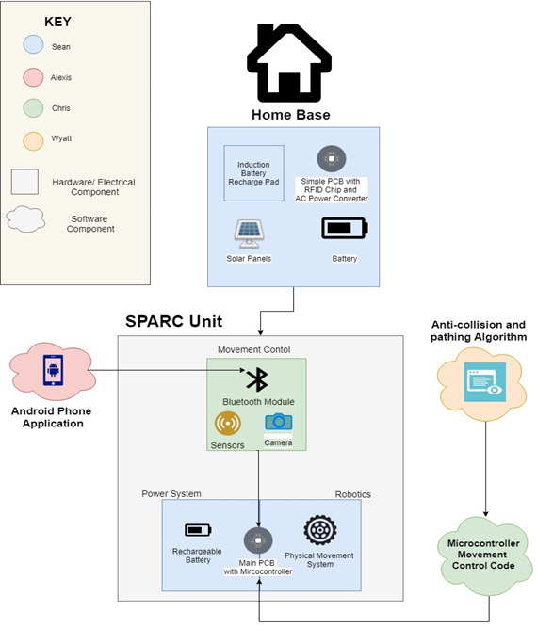
Notes:
Alexis: High Level Concept Block Diagram

Slide 5
Specifications and Requirements
Fully autonomous vehicle
Capable of carrying up to 50lbs
Fully rechargeable
User Interface with a Mobile Application
User manual control
User scheduled service
Automatically notify the user of important events
Collision avoidance capabilities
Sturdy and robust enough to handle trash collection
Waterproof
Battery capacity to traverse the user’s driveway in both directions.
Notes:
Important Events: Device out of Range, Moving back and forth from the curb

Slide 6
Operating Procedure
Wake up from standby based on internal clock, and scheduled time.
Locate self-GPS position and compare to destination GPS location.
Move to destination, avoiding obstacles.
Return to standby.
Wake up from standby for return trip based on schedule.
Return to Charge location, remembered from step 2.
Return to standby.

Slide 7
Charging Platform (Home Base)
Plugs into standard 120V AC Wall outlet.
AC/DC Laptop Charger with Barrel Jack
18V, 3A Output
Three 2A 16V Regulators for output to Main Unit
One 2A 5V Regulator to power RF Receivers.
Two RF Receivers (315MHz and 433MHz), into SR NOR Latch to enable or disable output from 16V Regulators

Slide 9
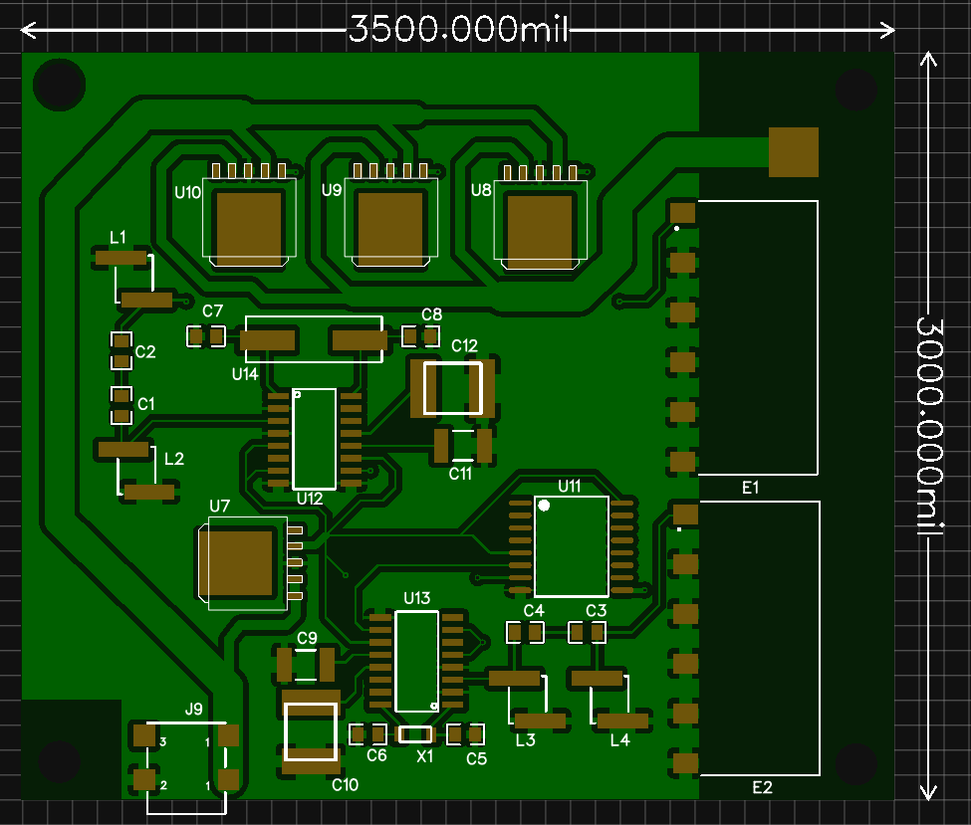
Power OUT
Power IN

Slide 10
Internal Power
14.8V Battery Bank
Thirty-Two 18650 Batteries, 4-series, 8 parallel, 20,000mAh
8 Overcharge Protection chips, 2 per series cell
Eleven 2A 12V Regulators for Motors
One 2A 5V Regulator for USB/PixyCam and IR Sensor
One 2A 3.3V Regulator for MCU, GPS, Bluetooth, and RF Transmitters.

Slide 11
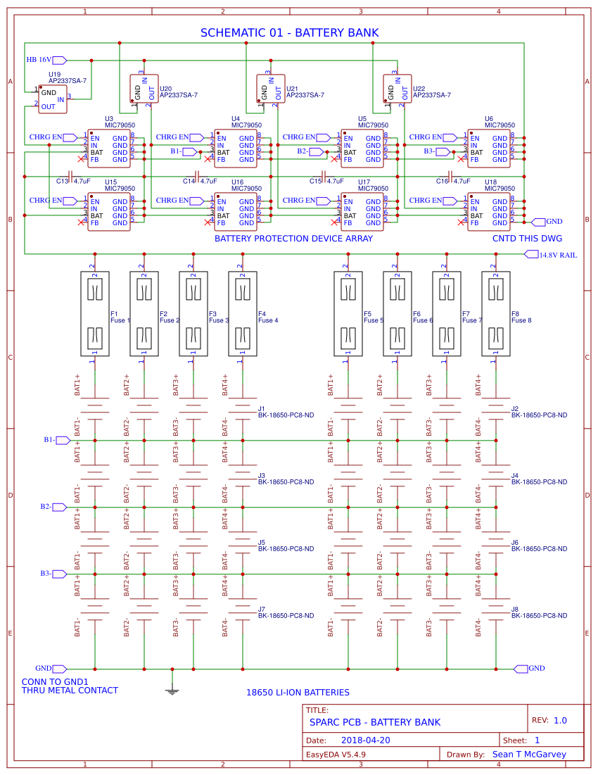
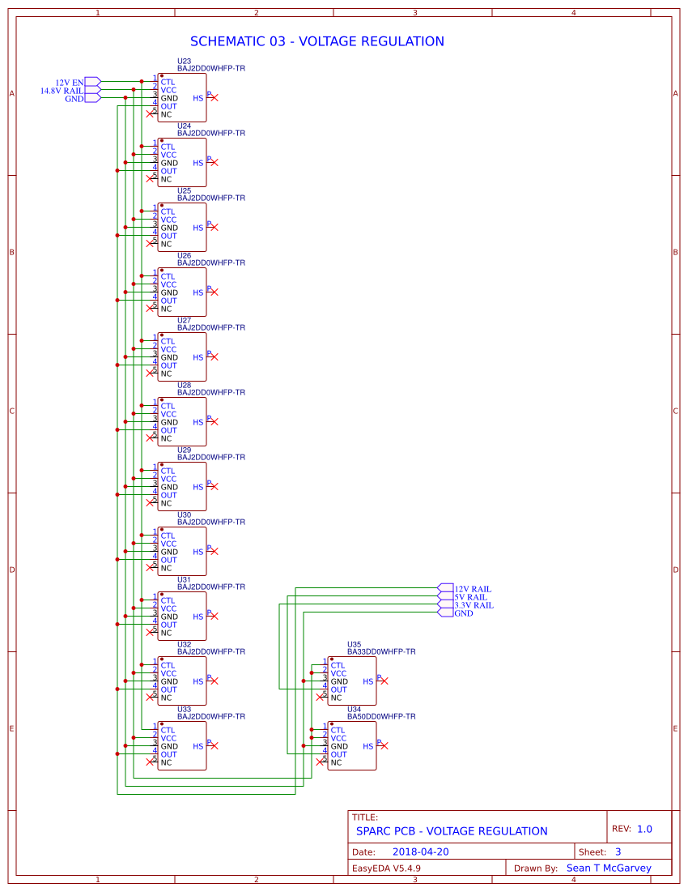

Slide 12
Motors
2 DC Motors,12V, 17200RPM, 4.47oz-in rate torque
6A draw at rated torque
Through 81:1 Gearbox
362.07 oz-in torque + 212 RPM after gearbox conversion.
Circuit designed to carry Max of 10A per motor
At 10A, 600 oz-in torque.
Should be able to pull 1200 oz. without damage to circuit.
50 Pounds of trash (estimated capacity of trash can) = 800 oz
Motors controlled by H-Bridge, controlled by MCU

Slide 13
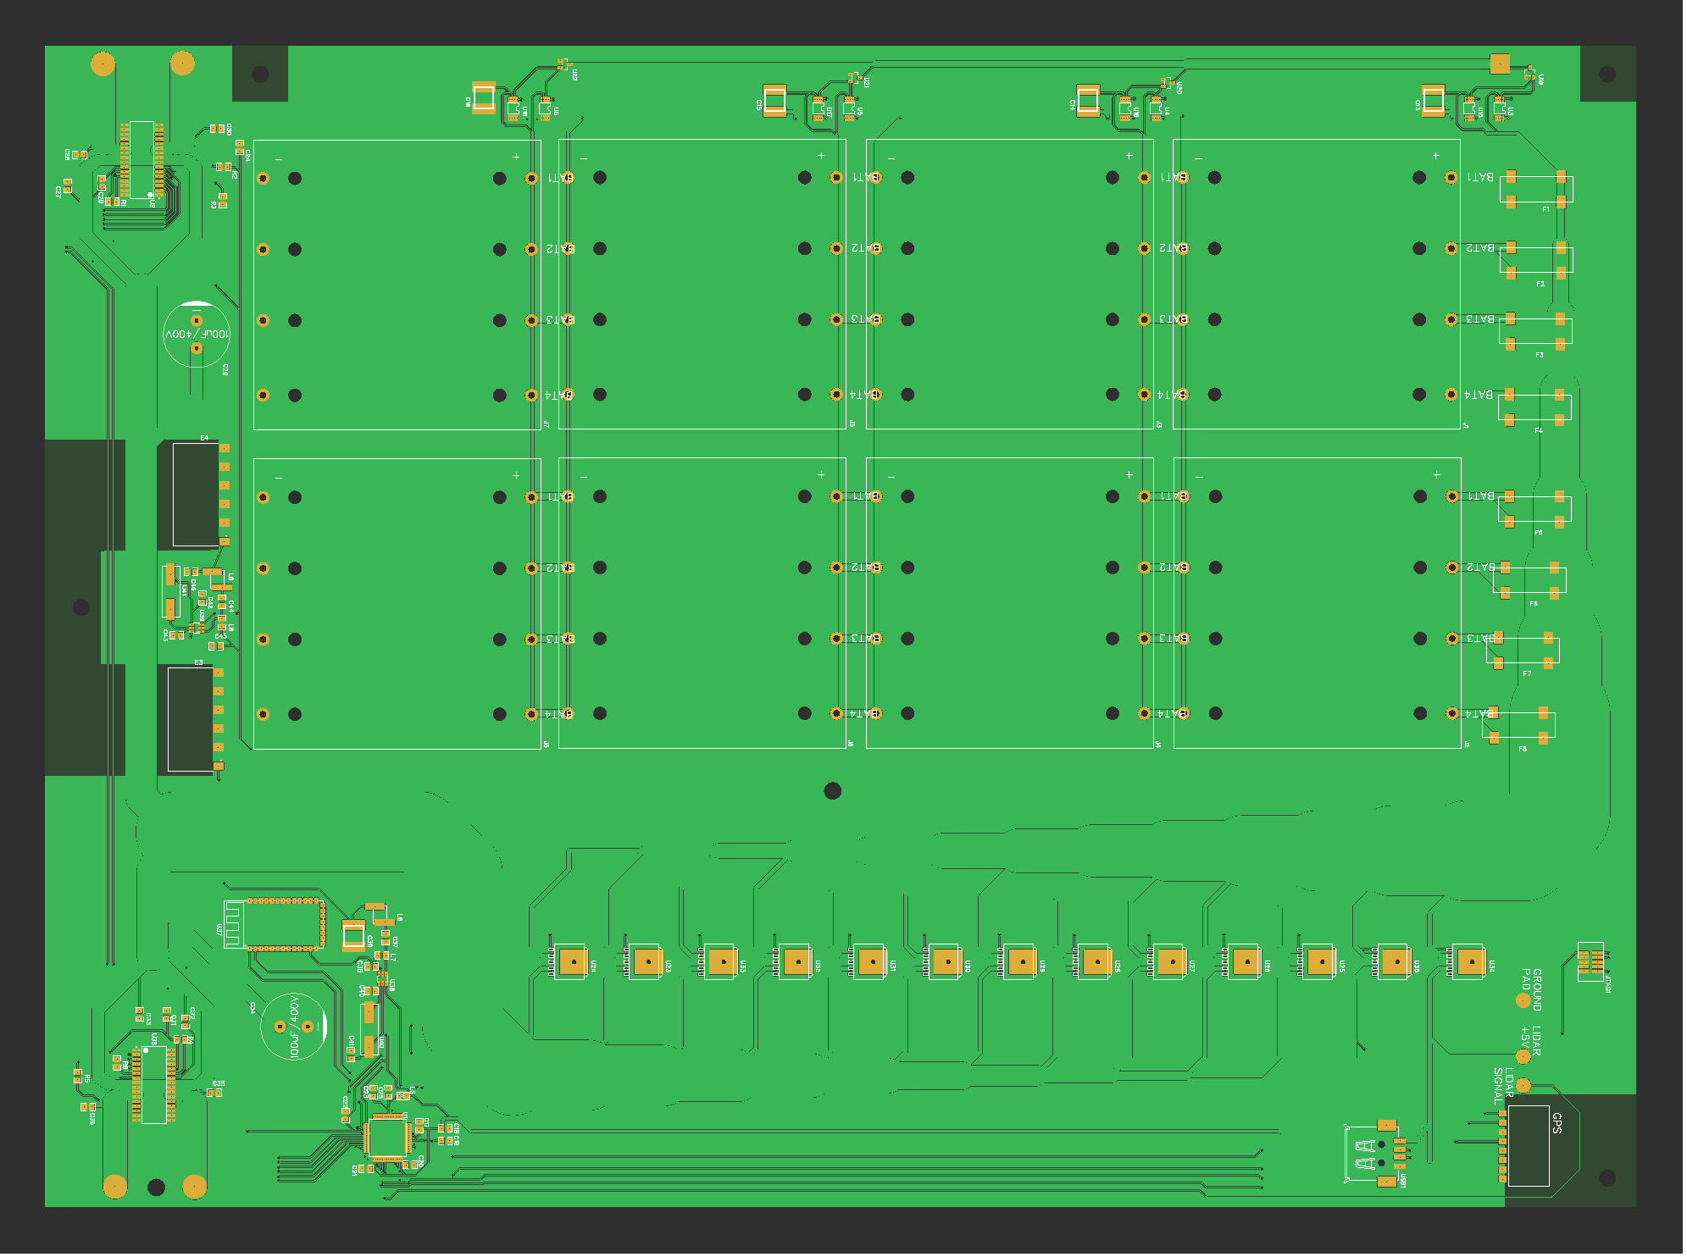

Slide 14
Chassis
Will be built from Aluminum, edges sealed to prevent rain damage.
6 wheels, middle wheels powered, front and back free rolling to allow easy turning.
Will have location to attach the trash can via straps.

Slide 15
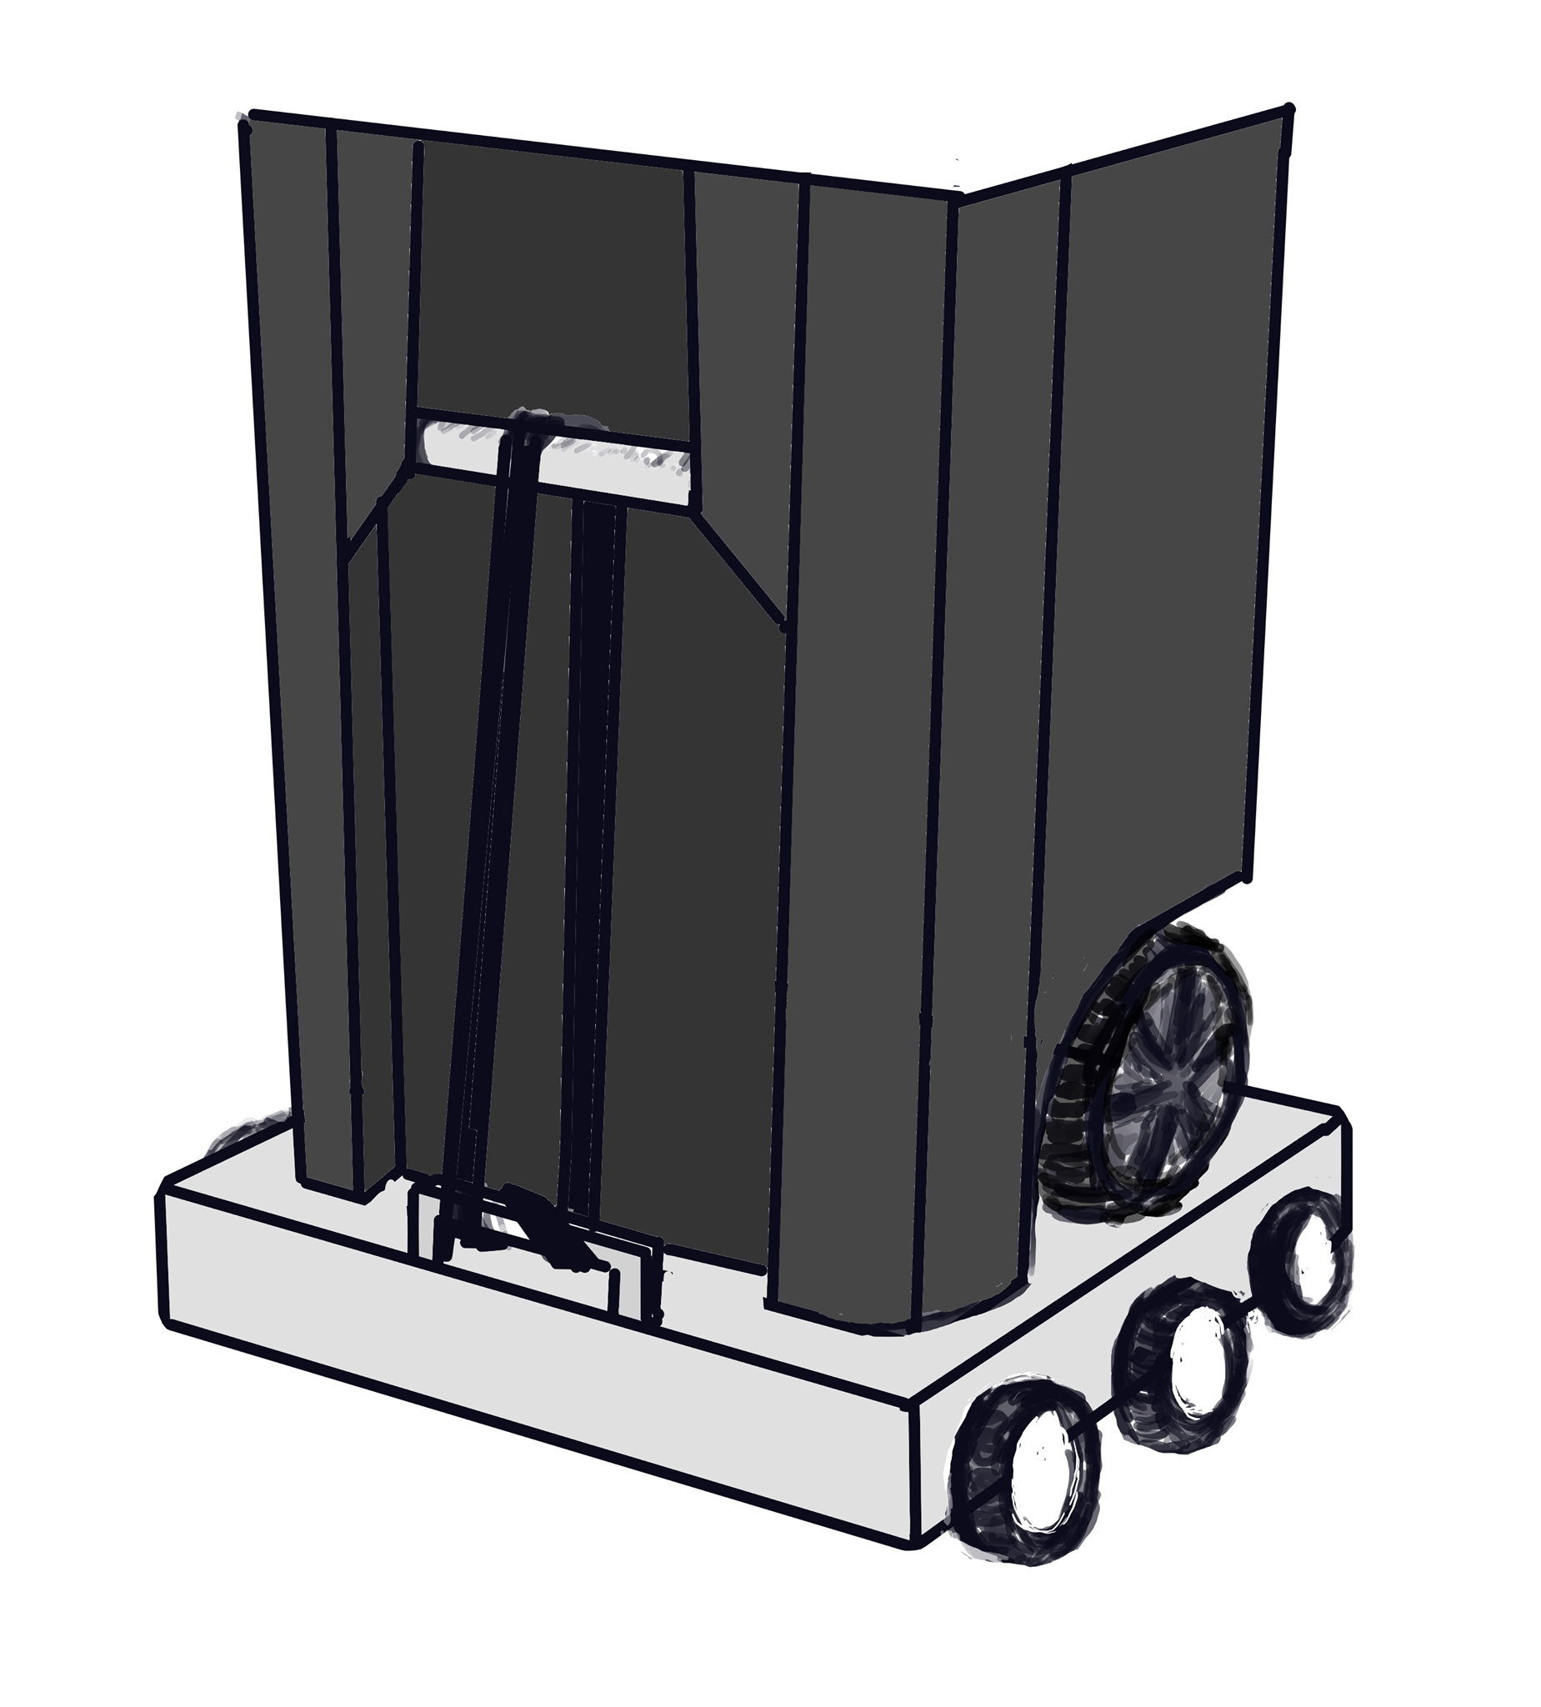
Concept Art

Slide 16
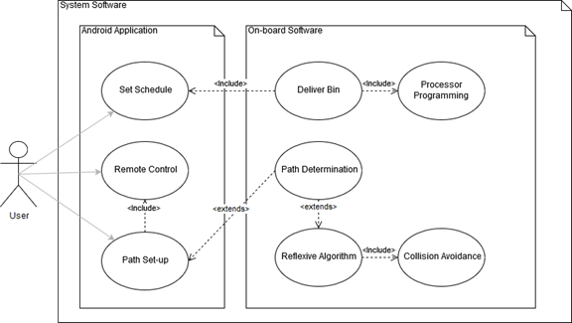
Software Development
Three Parts:
Pathing & Collision Avoidance
Firmware
Mobile Application

Slide 17
Pathfinding

Slide 18
Simultaneous Location and Mapping (SLAM)
Refers to Creating and/or Updating a graph of an undefined system while tracking an agent’s position in that space
Simply keeping track of the movement information of the agent is not enough; these measurements have margins of error and the amount of error compounds with operation space
This can be overcome by periodically referencing Landmarks to reorient the agent in the problem space.
Notes:
I know not all of you are doing Robot Vision projects, so I just wanted to summarize what SLAM is, and how it applies to the SPARC The original landmark is the starting location!

Slide 19
SLAM - Challenges for SPARC Design
Price point must be competitive; Taking out the trash is not likely to be worth several hundreds of dollars to the average user.
Fully mapping the operation area is not possible; unknown property boundaries must be respected
Artificial Landmarking has a very high utility cost in accessibility, which conflicted with our design goals of designing a device that has a high accessibility factor.
Notes:
Particular Challenges that are posed by the SPARC’s design problem. Needs to be inexpensive! No LIDAR, IR over Sonar/microwave Many other robot vision SD projects researched for the SPARC had a full mapping of the operational area before standard functionality begins; not possible for the SPARC as the operation space is not defined and bound legally. Adding markers for signaling makes the SPARC ever more difficult for users that have accessability challenges, which runs against our core design inspirations so use of this design solution must be minimal

Slide 20
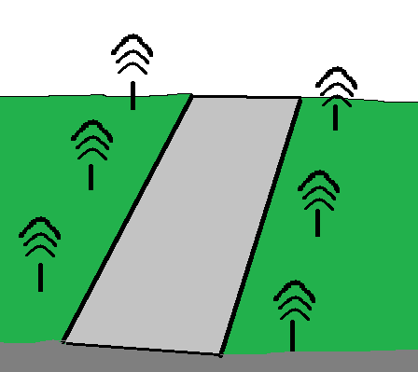
Alternate Design Concept
An early concept explored for the SPARC utilized passive RFID stakes to create a RTLS (real-time location system) with the SPARC crawler.
GPS design was preferable due to the low accessibility of this alternate design despite its low cost
Notes:
So, for the landmarking we had an early concept of using RFID due to its wide availability and low cost. It would create a system of nodes which could be used to triangulate the position of the SPARC within the problem space. This is similar to how GPS functions.

Slide 21
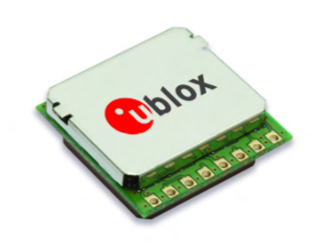
GPS Module
The Pam 7Q was selected for its relatively low cost and high accuracy.
The SPARC’s slow movement makes its slow baud rate a negligible drawback.
Part Name | Manufacturer | Price | Baud Rate | Accuracy
Pam-7Q | U-Blox America Inc. | $41 | 9600 bps | > 2.0 m
LS20031 | LOCOSYSA Technology Inc. | $60 | 57600 bps | ~ 2.5 m
Venus638FLPx-L | SkyTraq Technology Inc. | $50 | 115200 bps | ~ 2.5 m

Slide 22
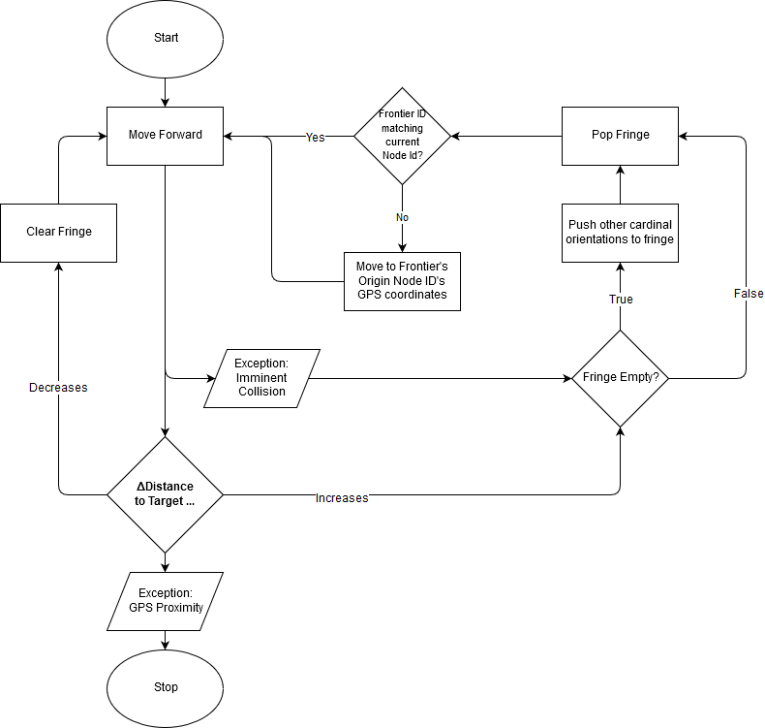
Algorithm Flowchart
Diagram

Slide 23
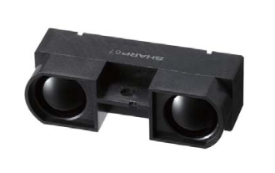
Rangefinding
Opted for Infrared over Ultrasonic; noise damping of shrubberies was of concern.
LiDAR too far out of price target
Part Name | Manufacturer | Price | Range | Type
GP2Y0A710K0F | SHARP | $16 | 100-550cm | Infrared
DE LiDar TF02 | Benewake | $99 | 0.4-22m | LIDAR
SEN136B5B | Seeed Studio | $15 | 3-400cm | Ultrasonic
Notes:
We opted

Slide 24
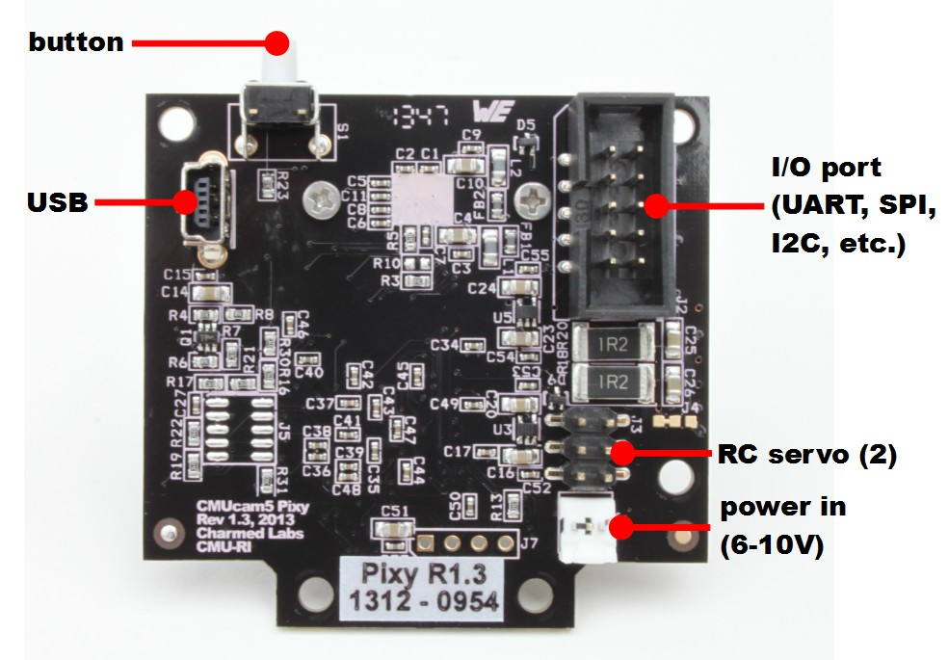
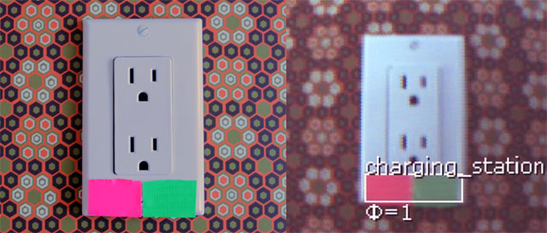
PixyCam
Integrated Computer Vision device we use to identify the start and endpoints.
Uses color filtering to identify pre-programmed objects.
Colored markers are applied on charge station and on single stake driven at the endpoint for high precision detection.

Slide 25
Value Iteration
 |  |  |  |  | 10 ●
 |  |  | 1 | 10
 |  | 2 | 10 | 1
 | 1 | 10 | 0 | 0
 | 3 | 10 | 0
 | 4 | 10 | 0
 | 4 | 10 | 0
 | 3 | 10 | 0
 |  |  | 10 ★
The SPARC learns about its problem space by recording information about each path it takes, and the locations of detected obstacles.
The user initializes a preferred path during setup utilizing the remote control feature of the mobile app.
Notes:
In this expample, the gold path is the one the user created using the remote control.
In this example, we could imagine that the user got a new roommate shortly thereafter who parks their car in the way of that main path.
The Sparc made a new ideal path that runs adjacent to their car using the algorithm previously described. The low numbers surrounding it represent the error in GPS measurement, though these spaces still lead the the destination in a comperable amount of time so they still have fair scores

Slide 26
Firmware

Slide 27
Microcontroller Comparison
A microcontroller needed to be chosen to run the code and interface with the modules
Microcontroller | Manufacturer | Total # of Pins | FLASH(KB) | SRAM (KB) | Cost
ATSAMD21J18A-AUT | Atmel | 64 | 256 | 32 | $3.39
MSP432P401RIRGC | Texas Instruments | 48 | 256 | 64 | $6.86
Decided on the ATSAMD21J18A-AUT (Arduino Zero chip) for its large number of pins, low cost, and compatibility with other components like the PixyCam

Slide 28
Firmware
Interfacing with the Bluetooth module and app
Pulling inputs from camera and other sensors
Sending output to motor control units (MCU)
Initiating standby modes and handling user-scheduled activation

Slide 29
Mobile Application

Slide 30
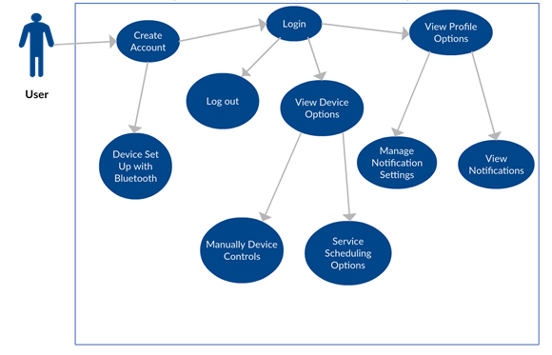
Mobile Application
The main connection between the user and the SPARC
Android Application
Bluetooth Connection
Service Scheduling and Monitoring
Manual Movement Control
Notes:
The User experience for the SPARC will be defined by the Mobile Application. It will be the main connection between the user and the device.

Slide 31
Bluetooth v Wifi
A wireless connection technology needed to be chosen to connect the application to the SPARC
Bluetooth chosen for this application that values low power consumption, price and ease of implementation
Protocol | Speed | Range | Power Consumption | Stability | Cost
Bluetooth | 25Mbps | 100m | Low | Only 2.4GHz bands | HC06: $$4.02
Wifi | 250Mbps | 200m to 400m | High | Both 2.4GHz and 5Hz bands | ESP8266:$6.95
Notes:
WiFi works on 2 bands (2.4GHz and 5Hz), if the device supports it can be switched between those bands and can select lesser noicy one. Bluetooth works with 2.4GHz.

Slide 32
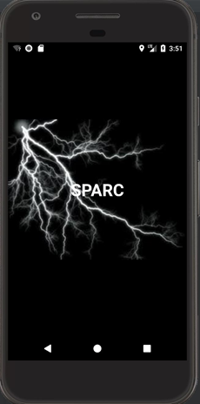
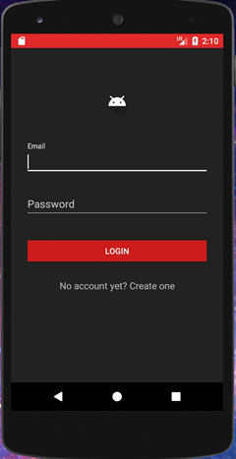
User Interface Design
Start Up Screen
Loads user data
Login Screen
User sign in

Slide 33
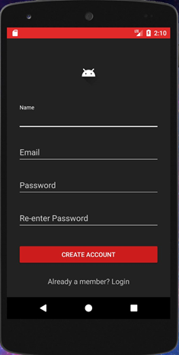
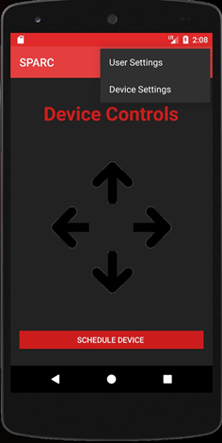
User Interface Design
Sign Up Screen
User account creation
Main Control Screen
SPARC movement controls
Device Scheduling controls
User settings
Device settings

Slide 34
Administrative Content

Slide 35
Budget
Main Components | Estimated Budget
Chassis and Trash Can containment parts | ~$200.00
Wheels and other Mechanics | ~$100.00
Printed Circuit Boards | ~$150.00
External Hardware Modules | ~$70.00
Miscellaneous Hardware parts | ~$100.0
Camera | ~$70.00
Power Supply Components | ~$200.00
Microcontroller and other electronics | ~$100.00
Estimated Total: | ~$1000

Slide 36
Work Distribution
 | Hardware | Mobile Application | Firmware | Pathing
Alexis Drayton |  | P | s
Sean McGarvey | P
Wyatt Schmitz | s |  |  | P
Chris Vento | s |  | P
P: Primary
s: Secondary
Notes:
Big X for main component
Little x for secondary component

Slide 37
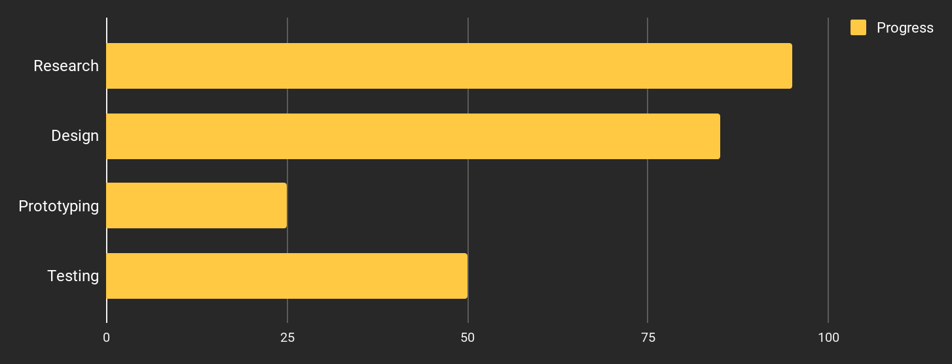
Work Progress
Notes:
Research 95%
Design 80-85%
Prototyping 25%
Testing 50%

Slide 38
Questions?

